Slide 1

CHAPTER 4
Solidification
and
Crystalline Imperfections

Slide 2
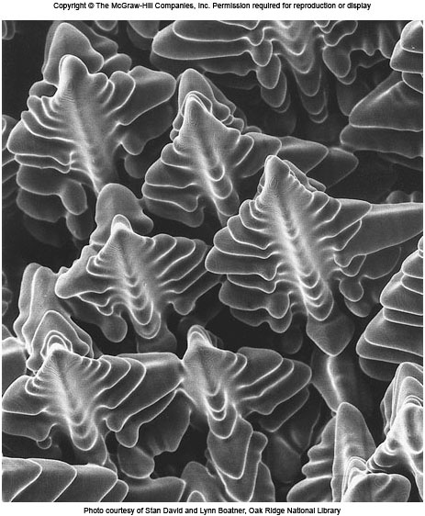
Ni-based Superalloy Dendrites
The solidification of the alloy takes place over a range of tempt.
A pasty form that consists of tree-like solid structures (dendrite) and liquid metal.
L → L + S (Dendrites) → S (Grains)

Slide 3
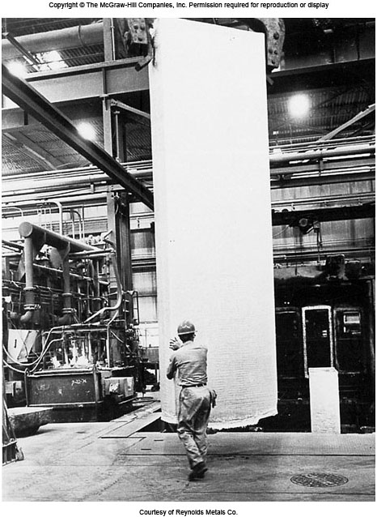
Semicontinuously Cast Al-ingot
Metals are melted to produce finished and semi-finished parts.
Fig. 4.1: Large, semicontinuously cast aluminum alloy ingot being removed from casting pit 鑄坑. Ingot of this type are subsequently hot- and cold-rolled into plate or sheet.

Slide 4
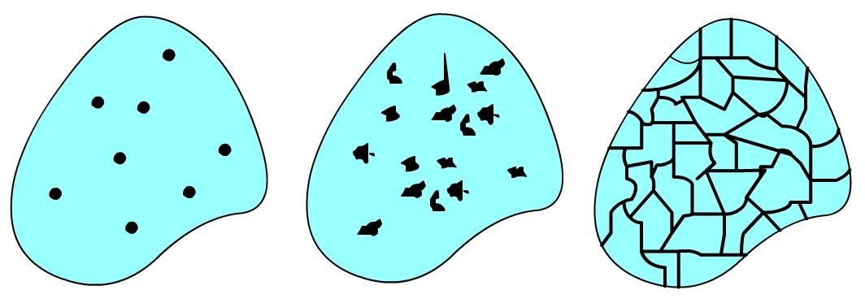
Solidification of Metals
Two steps of solidification
Nucleation: Formation of stable nuclei.
Growth of nuclei: Formation of grain structure.
Thermal gradients define the shape of each grain.
Grains
Nuclei
Crystals that will
Form grains
Grain Boundaries
Liquid

Slide 5
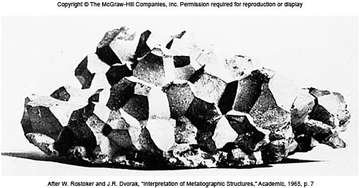
Cast Grain Structure of Ti
Fig. 4.3 A grain grouping parted from an arc-cast titanium alloy ingot under the blows of a hammer. The grouping has preserved the true bonding facets of the individual grains of the original cast structure. The grains are equiaxed since their growth is about equal in all direction.

Slide 6
Formation of Stable Nuclei
Two main mechanisms: Homogenous and Heterogeneous.
Homogenous Nucleation:
First and simplest case.
Metal itself will provide atoms to form nuclei.
Metal, when significantly undercooled, has several slow moving atoms which bond each other to form nuclei.
Cluster of atoms below critical size is called embryo.
If the cluster of atoms reach critical size, they grow into crystals. Else get dissolved.
Cluster of atoms that are grater than critical size are called nucleus.
胚核
核，晶核

Slide 7
Homogenous Nucleation均質孕核
Volume Free Energy ΔG_{V}
Released by liquid to solid transformation.
ΔG_{v} is change in free energy per unit volume between liquid and solid.
Free energy change for a spherical nucleus of radius r is given by
Surface Energy ΔG_{S}
Required to form new solid surface
ΔG_{S} is energy needed to create a surface.
γ is specific surface free energy.
Then
ΔG_{S} is retarding energy.

Slide 8
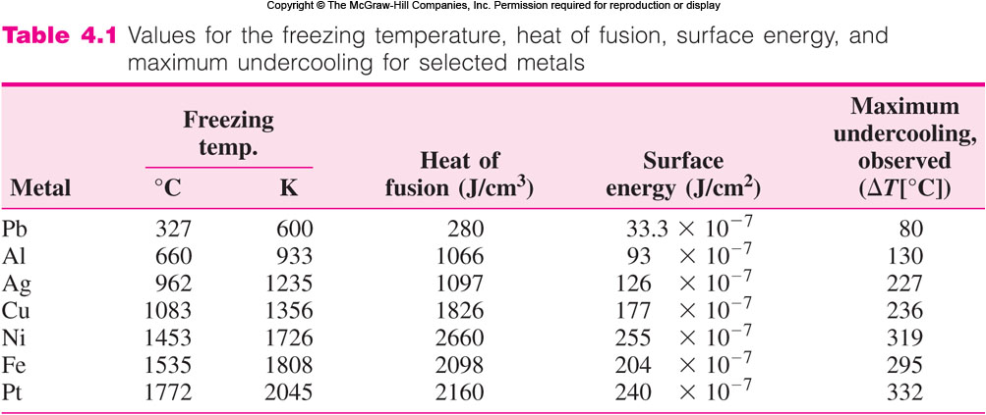
Homogenous Freezing Data
最大過冷
熔化熱

Slide 9
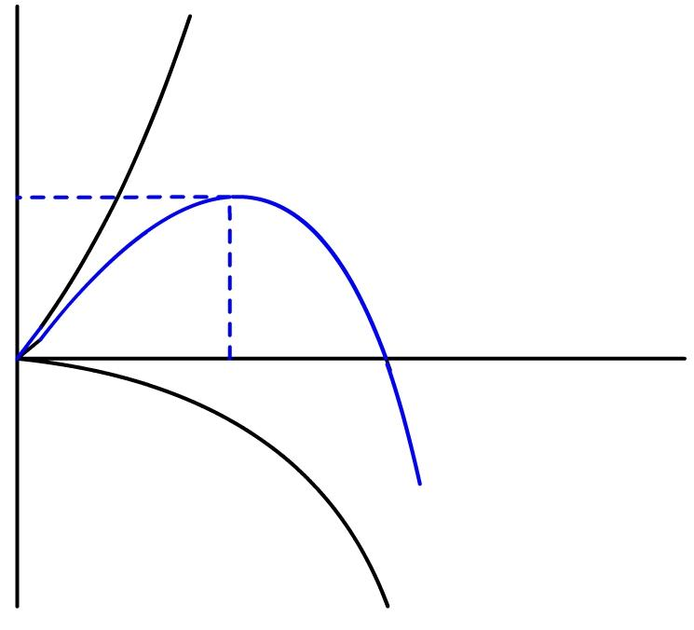
Total Free Energy Change
Total free energy is given by
When r = r*, d(ΔG_{T})/dr = 0 ∴
ΔG_{S}
+
Nucleus
ΔG_{T}
Above critical
radius r*
Below critical
radius r*
ΔG
r
r*
r*
Energy
lowered by
growing into
crystals
Energy
lowered by
redissolving
-
ΔG_{V}

Slide 10
Critical Radius Versus Undercooling
Greater the degree of undercooling, greater the change in volume free energy ΔG_{V.}
ΔG_{S} does not change significantly.
As the amount of undercooling ΔT increases, critical nucleus size decreases.
Critical radius is related to undercooling by relation
r* = Critical radius of nucleus
γ = Surface free energy
ΔH_{f} = Latent heat of fusion
ΔT = Amount of undercooling.

Slide 11
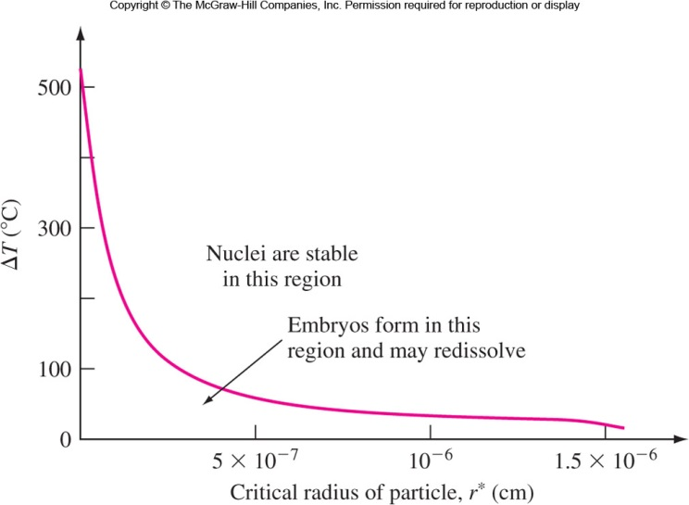
Critical Cu Radius Versus ΔT
晶核
胚核
5 nm

Slide 12
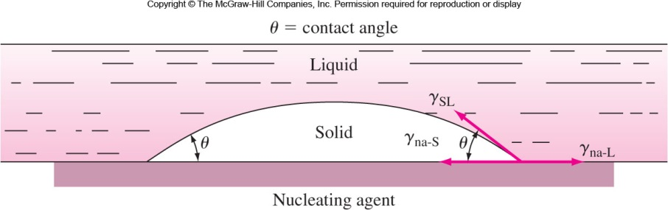
Heterogeneous Nucleation
Nucleation occurs in a liquid on the surfaces of structural material. e.g.: Container surface, Insoluble impurities.
These structures, called nucleating agents, lower the free energy required to form stable nucleus.
Nucleating agents also lower the critical size.
Smaller amount of undercooling is required to solidify. 0.1-10 K vs. 100-300 K. Used excessively in industries.

Slide 13

Growth of Crystals and Grain Structure
Nucleus grow into crystals in different orientations.
Crystal boundaries are formed when crystals join together at complete solidification.
Crystals in solidified metals are called grains. Polycrystalline.
Grains are separated by grain boundaries.
More the number of nucleation sites available, more the number of grains formed.
Coarse grain vs. fine grain
多晶
Nuclei growing into grains
forming grain boundaries

Slide 14
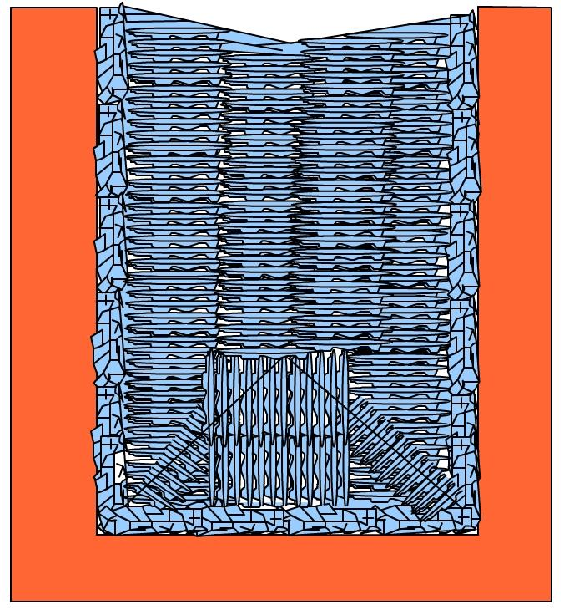
Types of Grains
Equiaxed Grains等軸晶:
Crystals, smaller in size, grow equally in all directions.
Formed at the sites of high concentration of the nuclei.
Example: Cold mold wall (Large undercooling)
Columnar Grains柱狀晶:
Long thin and coarse.
Grow predominantly in one direction.
Formed at the sites of slow cooling
and steep temperature gradient.
Example: Grains that are away from the mold wall.
Mold
Columnar Grains
Equiaxed Grains

Slide 15
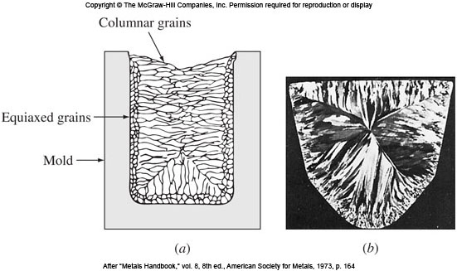
Solidification Structure
Fig. 4.7 (a) Schematic drawing of a solidification metal grain structure produced by using a cold mold. (b) Transverse section through an ingot of Al-1100 (99.0% Al).

Slide 16
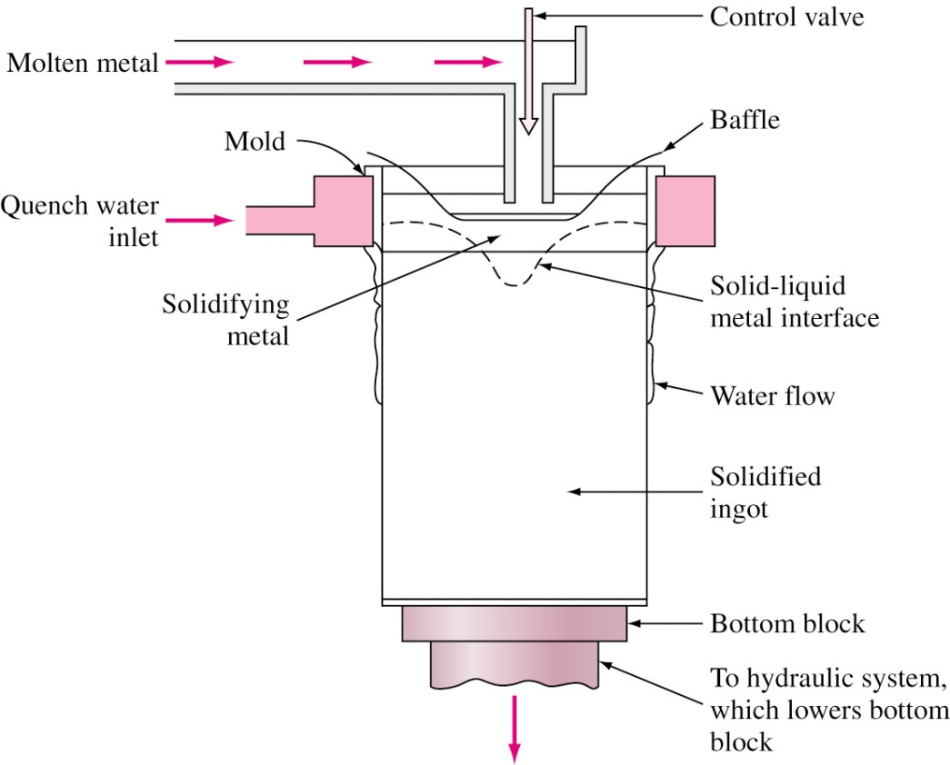
Casting in Industries
In industries, molten metal is cast into either semi finished or finished parts.
Forgings vs. Casting
Sheet ingot板鑄錠vs. Extrusion billet擠錠
In the steel industry, 60%: Stationary molds; 40%: Continuous casting.
Direct-Chill semicontinuous
casting unit for aluminum
Iron Smelting: Video

Slide 17
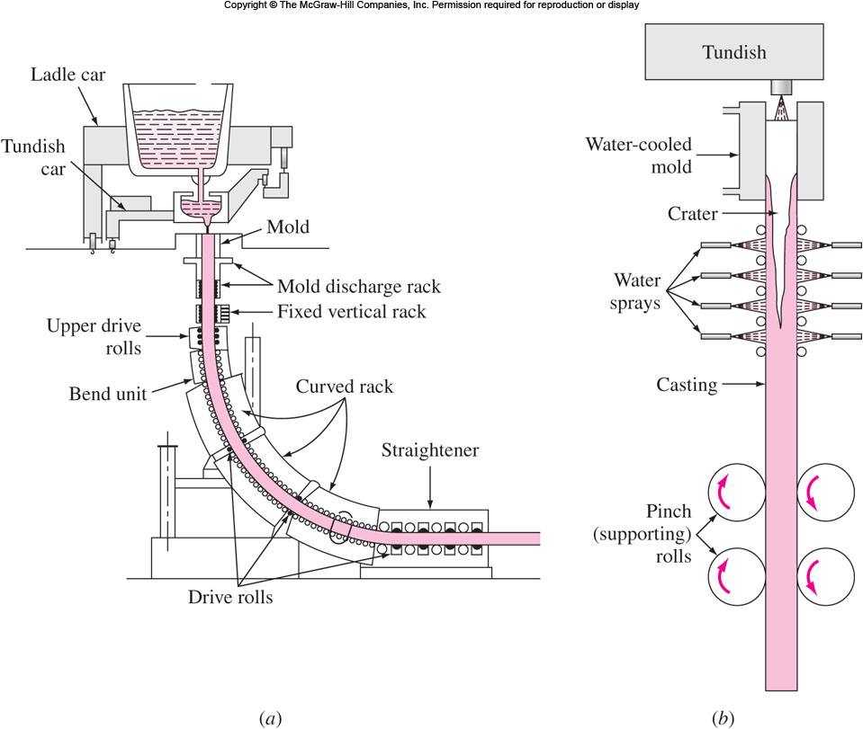
Continuous Casting
Slab or Stripe 厚坯或薄片

Slide 18
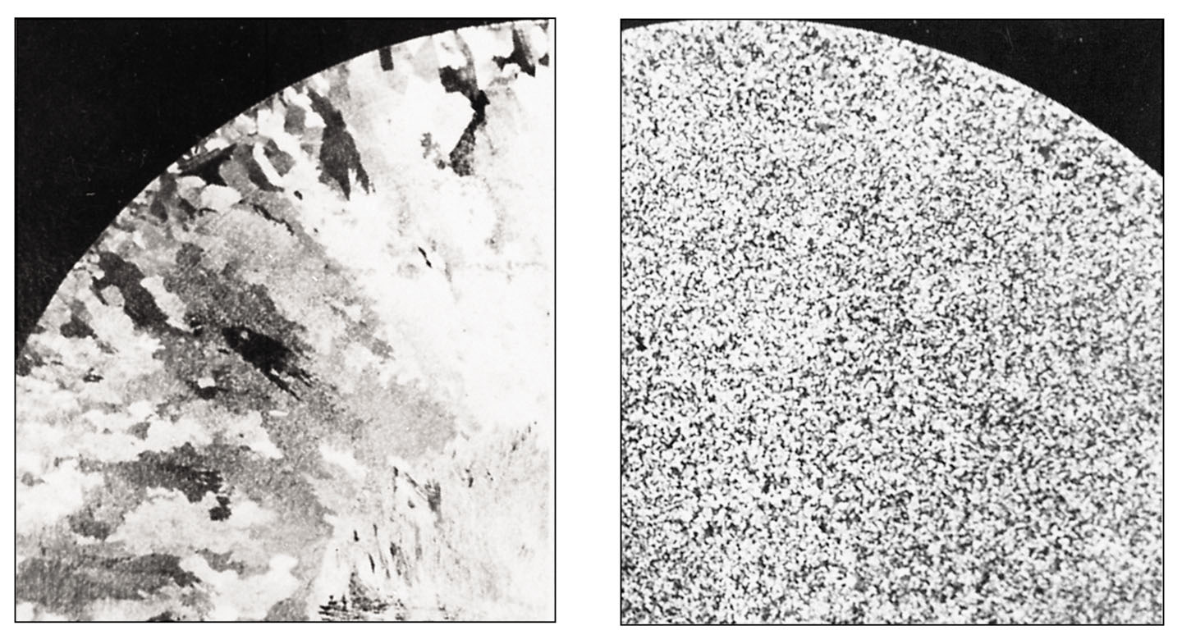
Grain Structure in Industrial Castings
To produce cast ingots with fine grain size, grain refiners are added. Fine dispersion of heterogeneous nuclei.
Example: For aluminum alloy, small amount of Titanium, Boron or Zirconium is added.
晶粒細化劑
Grain structure of
Aluminum cast
(0.15-m-diameter extrusion ingot) without (a) and
with (b) grain refiners.
(a)
(b)

Slide 19
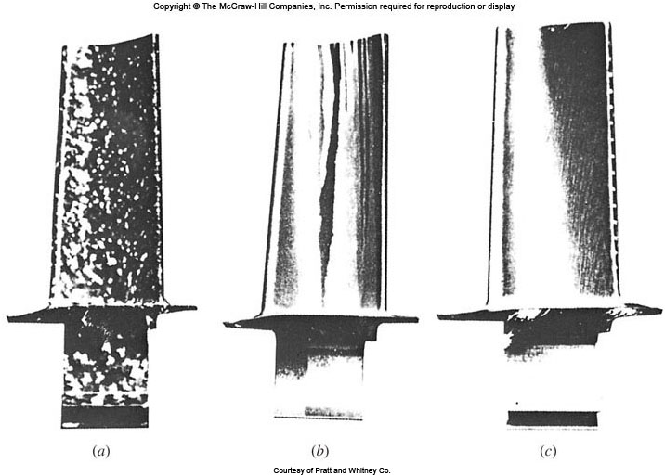
Solidification of Single Crystal
氣渦輪葉片
For some applications (e.g.: Gas turbine blades-high temperature environment), single crystals are needed.
Single crystals have high temperature creep resistance.
Latent heat of solidification is conducted through solidifying crystal to grow single crystal.
Growth rate is kept slow so that temperature at solid-liquid interface is slightly below melting point.
(a) Equiaxed grain vs. (b) Columnar grain vs. (c) Single crystal
抗潛變

Slide 20
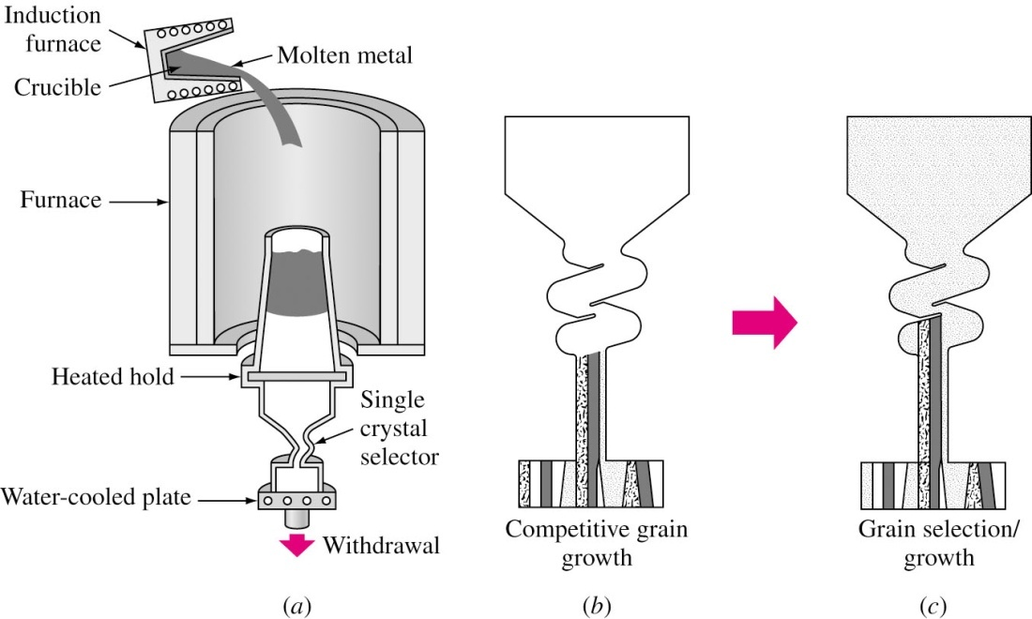
Producing a Single Crystal
Starter with a pigtail
(single -crystal selector)
選晶器
Fig. 4.12 Growth of single crystal for turbine airfoil渦輪翼片.

Slide 21
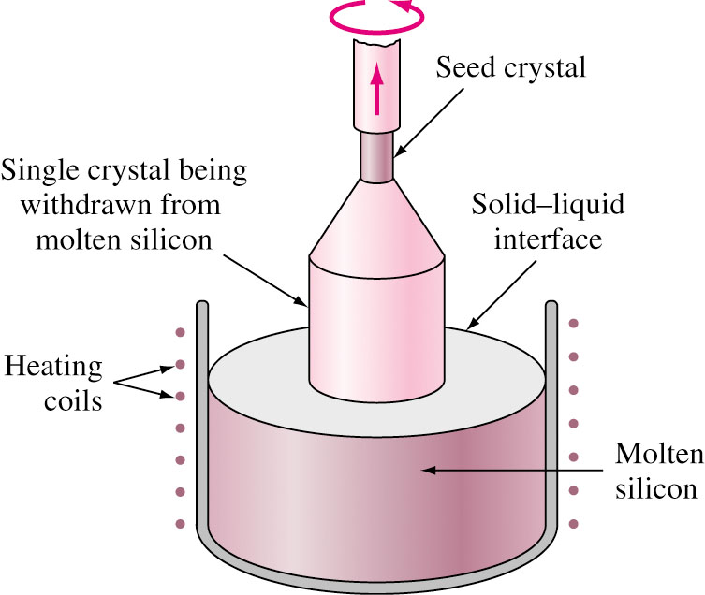
Czochralski Process
This method is used to produce high-quality single crystal of silicon for IC wafers.
A seed crystal is dipped in molten silicon and rotated.
The seed crystal is withdrawn slowly while silicon adheres to seed crystal and grows as a single crystal (12”).
種晶

Slide 22
Metallic Solid Solutions
Pure form: 99.99% Cu for electronic wires, 99.99% Al for decorative proposes (very bright metallic surface).
Alloys are used in most engineering applications: higher strength, corrosion resistance….
Alloy is an mixture of two or more metals and nonmetals.
Example:
Cartridge brass is binary alloy of 70% Cu and 30% Zinc.
Inconel 718 is a nickel based superalloy with 7 elements (50~55Ni-17~21Cr-4.75~5.50(Nb+Ta)-Balance Fe-2.8~3.3Mo-0.65~1.15Ti-0.20-0.80Al-<1.0Co-<0.08C-<0.015P….)
Solid solution (固溶體) is a simple type of alloy in which elements are dispersed in a single phase. Substitutional or Interstitial solid solution.
炮管黃銅
取代型或填隙型

Slide 23
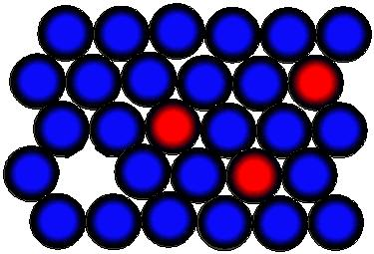
Substitutional Solid Solution
Solute atoms substitute for parent solvent atom in a crystal lattice.
The structure remains unchanged.
Lattice might get distorted due to change in diameter of the atoms.
Solute percentage in solvent can vary from a fraction of an atomic percent to 100%.
(111) of FCC
Solvent atoms
Solute atoms

Slide 24
Substitutional Solid Solution (Cont..)
Hume-Rothery rules: The solubility of solids is greater if
The diameter of atoms not differ by more than 15%.
Crystal structures are the same.
No appreciable difference in electronegativity (else compounds will be formed).
Have same valence.
Examples:
System | Atomic radius difference | Electro- negativity difference | Maximum solid solubility
Cu-Zn | 3.9% | 0.1 | 38.3 at%
Cu-Pb | 36.7% | 0.2 | 0.17 at%
Cu-Ni | 2.3% | 0 | 100 at%
Cu-Si | 8.6% | 0 | 11.2 at%

Slide 25
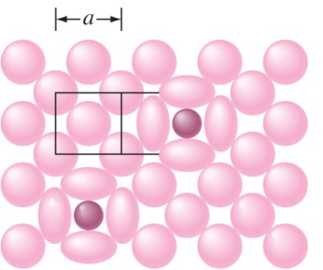
Interstitial Solid Solution
Solute atoms fit in between the voids (interstices) of solvent atoms.
Solvent atoms in this case should be much larger than solute atoms.
Example: between 1185 and 1667 K, interstitial solid solution of carbon in γ iron (FCC) is formed.
A maximum of 2.08 wt% (FCC, 1421 K) or 0.025 wt% (BCC, 996 K) of carbon can dissolve interstitially in iron.
Iron atoms r = 0.129 nm
FCC voids = 0.053 nm
(BCC voids = 0.036 nm)
Carbon atoms r = 0.075 nm
(100) of FCC γ-Fe

Slide 26
Crystalline Imperfections
No crystal is perfect.
Imperfections affect mechanical properties, chemical properties and electrical properties.
Imperfections can be classified as
Zero dimensional or point defects.
One dimensional or line defects (dislocations).
Two dimension defects (surfaces, grain or twin boundaries).
Three dimension defects (pores, inclusions, cracks).
差排
雙晶
介在物

Slide 27
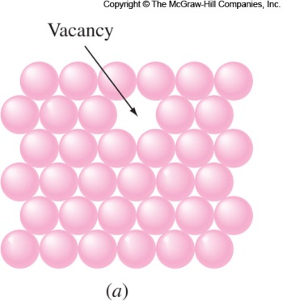
Point Defects – Vacancy
空位
Vacancy is formed due to a missing atom.
Vacancy is formed (≤ 1 vacancy/10000 atoms) during crystallization or mobility of atoms.
Also caused due to plastic deformation, rapid cooling or particle bombardment.
Energy of formation is about 1 eV.
Mobility of vacancy results in cluster of vacancies. Divacancies, Trivacancies.
Vacancies can move by exchanging positions with their neighbors (Diffusion).
擴散

Slide 28
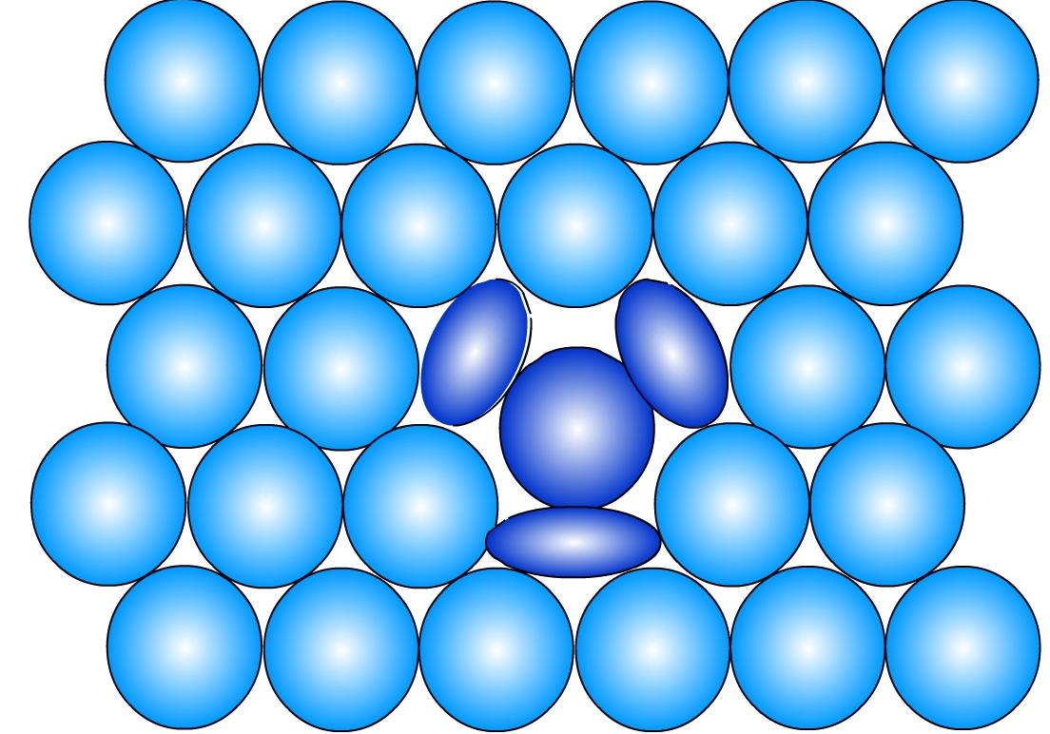
Point Defects - Interstitialcy
Interstitialcy (Self-interstitial): Atom in a crystal occupies interstitial site.
This does not occur naturally. Can be induced by irradiation.
This defect caused structural severe distortion.

Slide 29
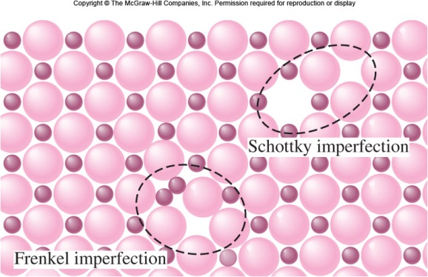
Point Defects in Ionic Crystals
Complex as electric neutrality has to be maintained.
If two oppositely charged particles are missing, cation-anion divacancy is created. This is Scohttky imperfection.
Frenkel imperfection is created when cation moves to interstitial site.
These defects increase their electrical conductivity.
Impurity atoms are also considered as point defects.
Si + a few impurity → resistivity ↑↑

Slide 30
Line Defects – (Dislocations)
Lattice distortions are centered around a line.
Formed during
Solidification
Permanent or plastic deformation
Vacancy condensation
Different types of line defects are
Edge dislocation
Screw dislocation
Mixed dislocation

Slide 31
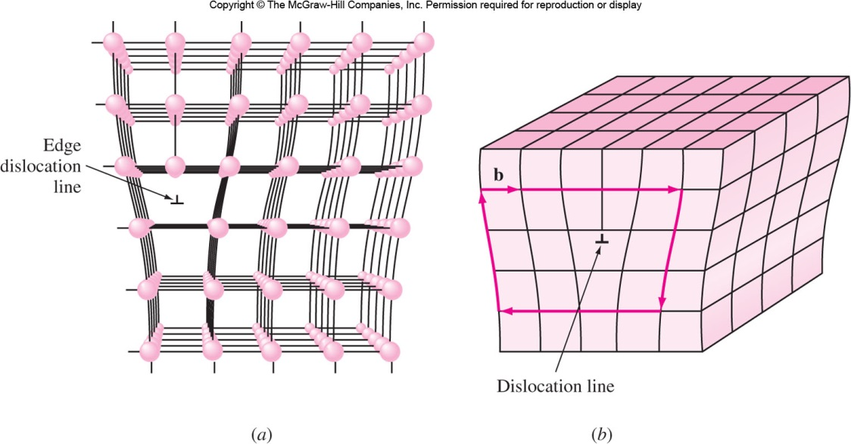
Edge Dislocation
Created by insertion of extra half planes of atoms.
: Positive edge dislocation; : Negative edge dislocation
Burgers vector (slip) b shows displacement of atoms.
Burgers vector b

Slide 32
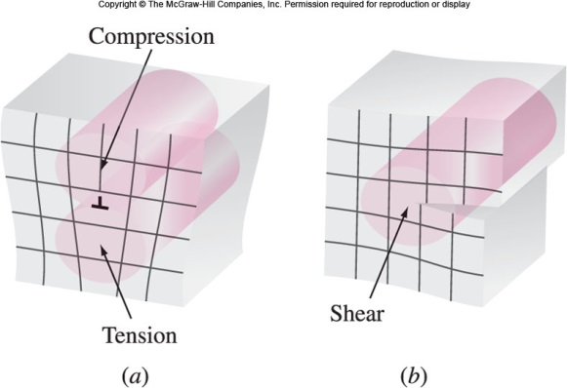
Strain Fields of Dislocations
Edge Dislocation
Screw Dislocation

Slide 33
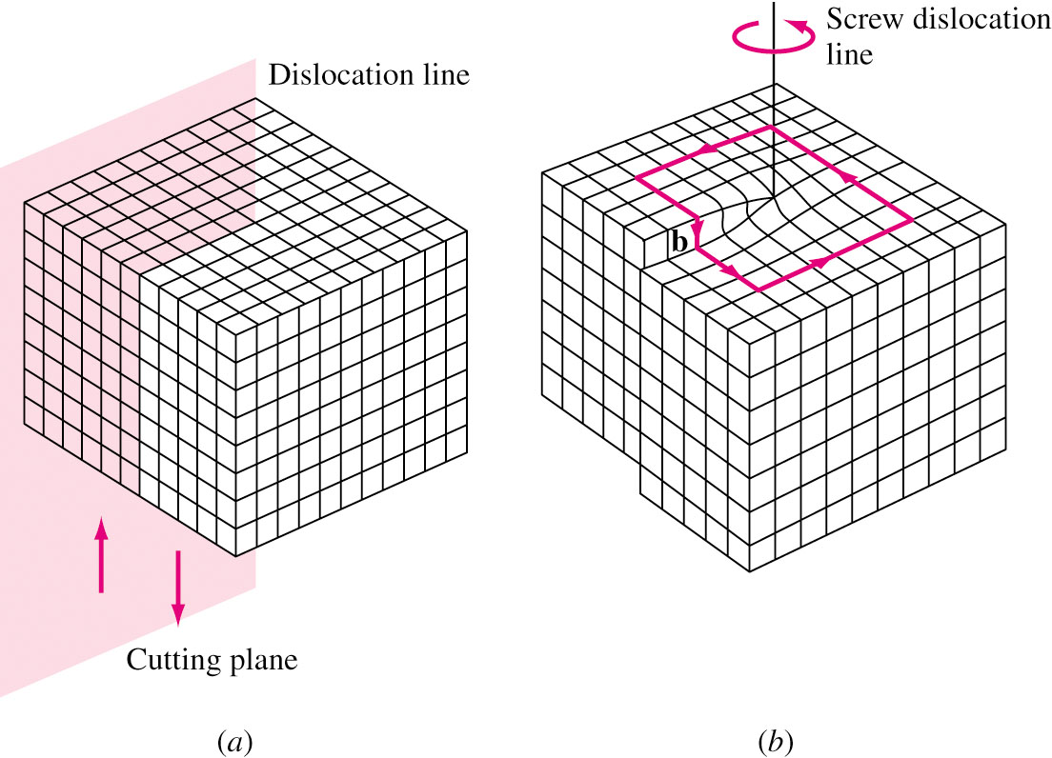
Screw Dislocation
Created due to shear stresses applied to regions of a perfect crystal separated by cutting plane.
Distortion of lattice in form of a spiral ramp.
Burgers vector is parallel to dislocation line.
6
6
6
6

Slide 34
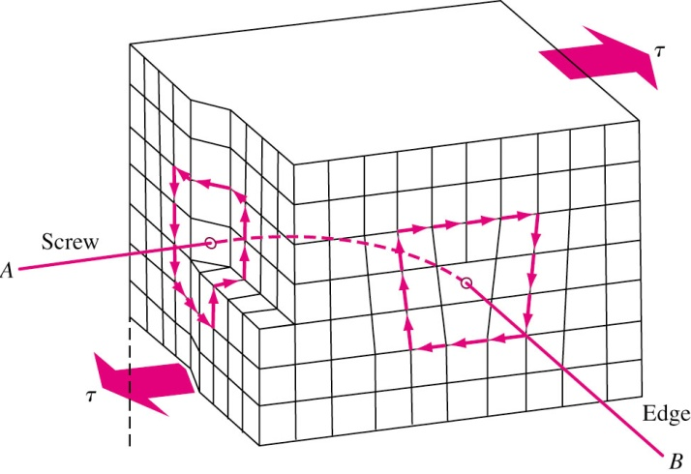
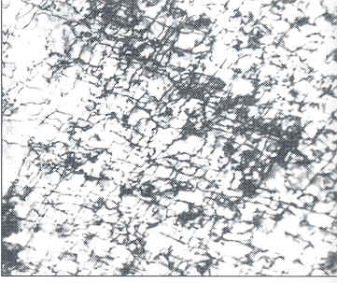
Mixed Dislocation
Most crystal have components
of both edge and screw
dislocation.
Dislocation, since irregular atomic arrangement will appear as dark lines when observed in electron microscope.
Mixed
Dislocation structure of iron deformed 14% at –195 °C

Slide 35
Planar Defects
Free surfaces, grain boundaries, twins雙晶, low angle boundaries, twists 扭旋 and stacking faults 疊差.
Free surface is the most common type: Bonded to atoms on only one side and hence has higher state of energy. Highly reactive (corrosion, reaction)
Nanomaterials have small clusters of atoms and hence are highly reactive.

Slide 36
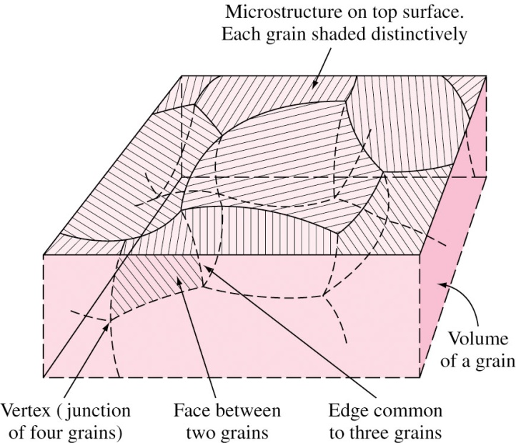
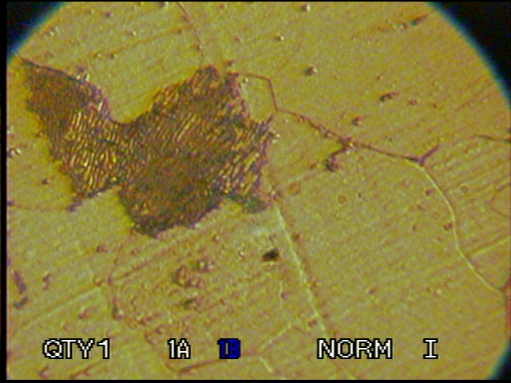
Grain Boundaries
Formed due to simultaneously growing crystals meeting each other. Grain boundaries separate grains.
Width = 2-5 atomic diameters. Atomic packing is lower.
Atoms in grain boundaries have higher energy.
Grain boundaries: Restrict plastic flow and prevent dislocation movement. Nucleation sites, Rapid diffusion region.
3D view of
grains
Grain boundaries
in 1018 steel

Slide 37
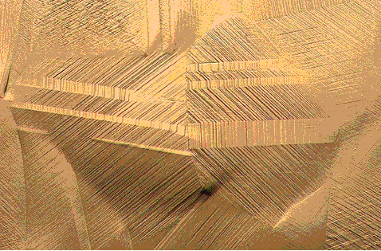
Twin Boundaries
Twin: A region in which mirror image of the structure exists across a boundary.
Formed during plastic deformation (deformation twin) and recrystallization 再結晶 (annealing 退火 twin).
Twin boundaries form in pairs.
Strengthens the metal.
Twin Plane
Twin

Slide 38
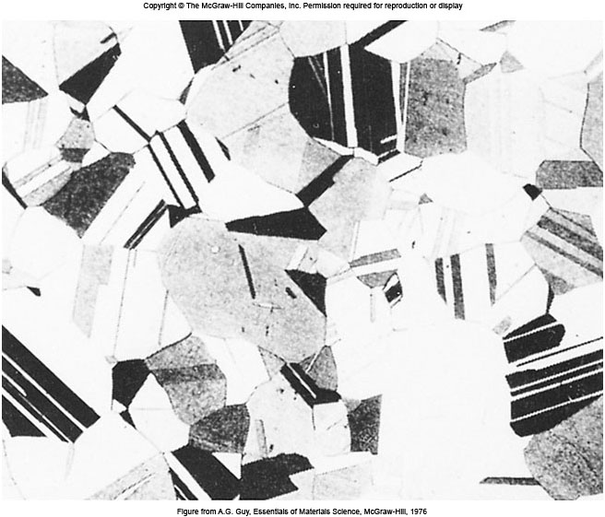
Annealing Twins
Fig. 4.23 Twin boundaries in the grain structure of brass.

Slide 39
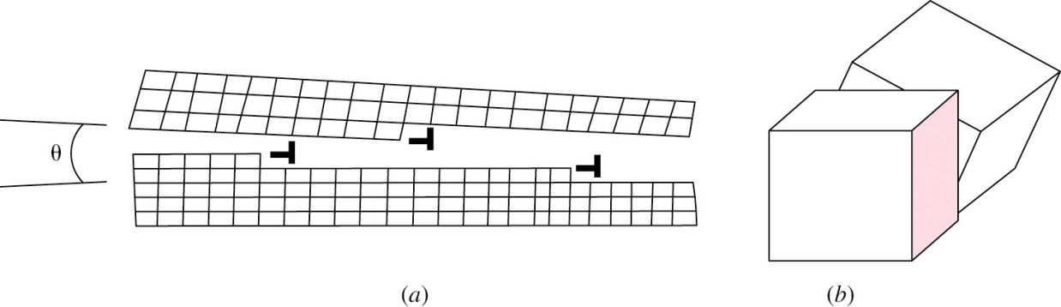
Other Planar Defects
Small angle boundary: Array of dislocations tilts (edge disl.) or twists (screw disl.) two regions of a crystal by < 10°; high energy and strengthen.
Stacking faults: Piling up faults during crystal growth, collapse of vacancies, disl. interaction.
ABCABABCABC…(FCC fault); ABABCABAB…(HCP fault)
Volume defects: Cluster of point defects join to form 3-D void. Three dimensional precipitates or inclusions. Tremendous effect on the behavior of the materials.

Slide 40
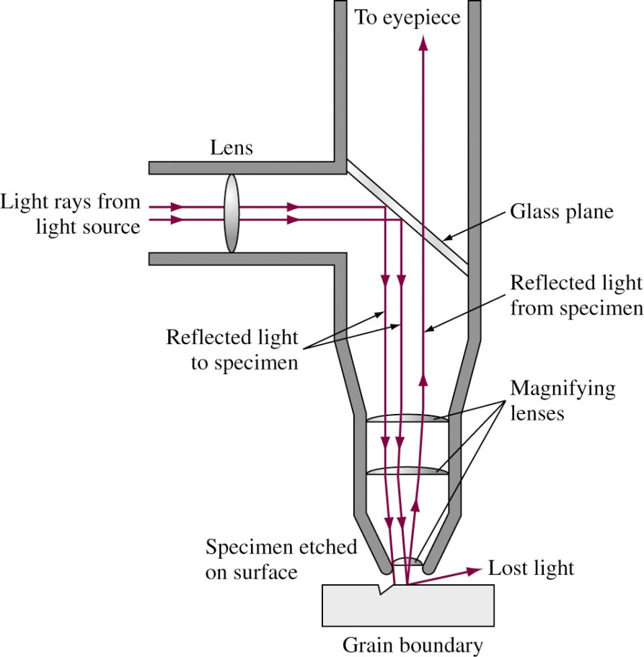
Optical Metallography金相
Microstructure Analyses: OM, SEM, TEM, HRTEM, STM.
To observe grain boundaries, the metal sample must be first mounted for easy handling.
Then the sample should be ground and polished with different grades of abrasive paper and abrasive solution.
The surface is then etched chemically.
Tiny groves are produced at grain boundaries.
Groves do not intensely reflect light. Hence observed by optical microscope.
Impurities, Phases, Defects….

Slide 41
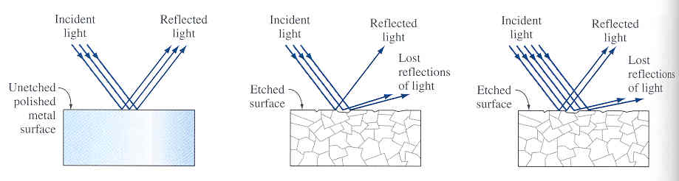
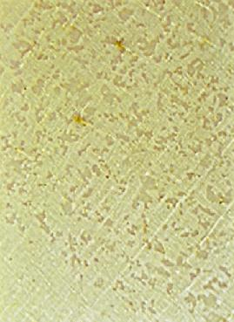
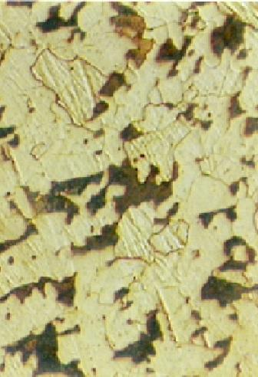
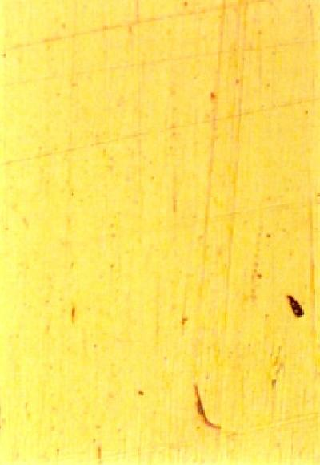
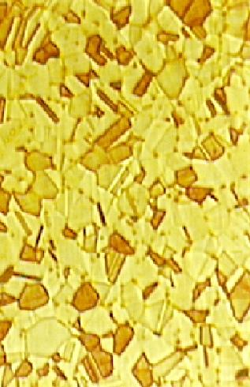
Effect of Etching 蝕刻
Unetched
Brass
200×
Etched
Brass
200×
Unetched
Steel
200×
Etched
Steel
200×

Slide 42
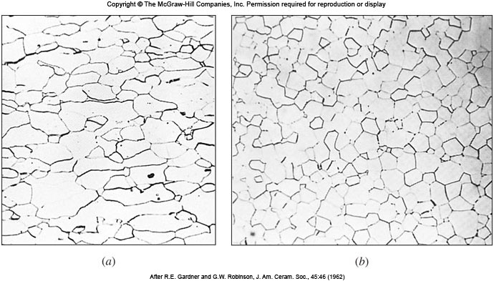
Grain Boundaries (OM)
Fig. 4.27 Grain boundaries on the surface of polished and etched samples as revealed in the optical microscope. (a) Low-carbon steel, 100×. (b) Magnesium oxide, 225×

Slide 43
Grain Size
Grain size affects the mechanical properties of the material.
The smaller the grain size, more are the grain boundaries.
More grain boundaries means higher resistance to slip (plastic deformation occurs due to slip) and strengthens metals.
At elevated temperature, grain boundary sliding may occur, and grain boundaries can become regions of weakness in polycrystalline metals.
ASTM grain size number ‘n’ is a measure of grain size.
N = 2^{n−1}
N = Number of grains per square 2.54 × 10⁻² m of a polished and specimen at 100 ×.
n = ASTM grain size number.
n < 3 – Coarse grained
4 < n < 6 – Medium grained
7 < n < 9 – Fine grained
n > 10 – Ultrafine grained

Slide 44
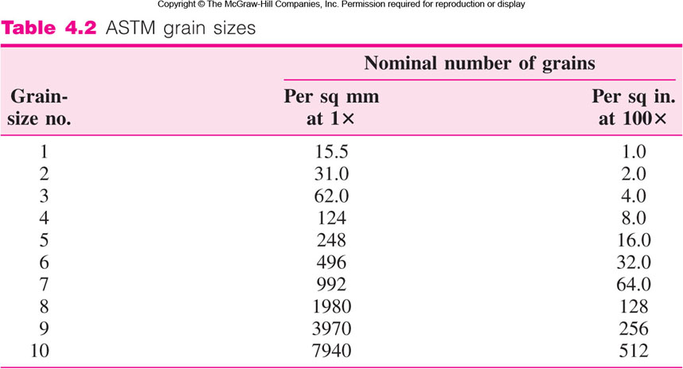
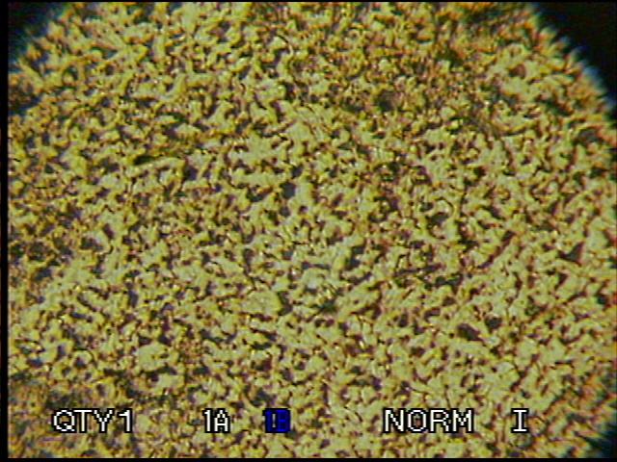
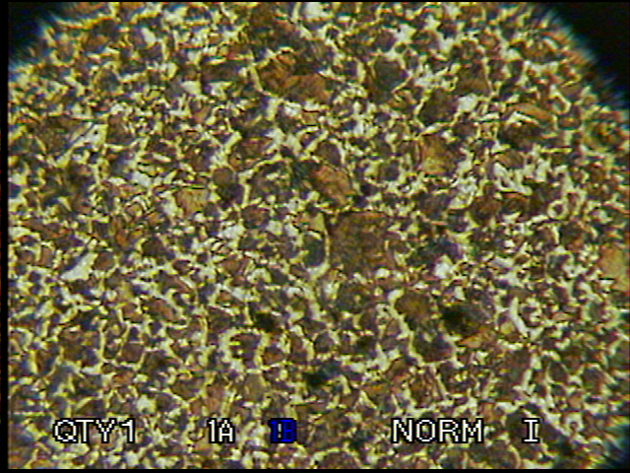
μm 226 160 113 80 57 40 28 20 14 10
200 ×
200 ×
1018 cold rolled steel, n = 10
1045 cold rolled steel, n = 8

Slide 45
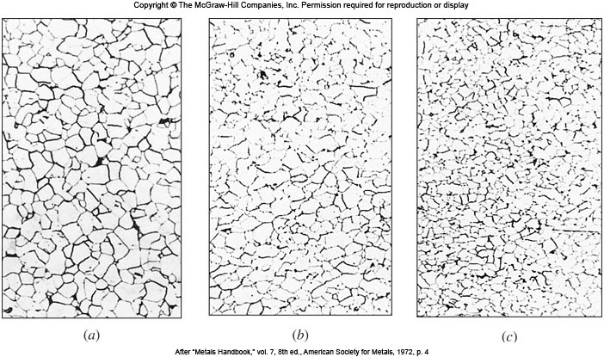
Grain Size (Cont..)
Fig. 4.28 Several nominal ASTM grain sizes of low-carbon steels: (a) n = 7, (b) n = 8, and (c) n = 9.

Slide 46
Average Grain Diameter
Average grain diameter more directly represents grain size.
Random line of known length is drawn on photomicrograph.
Number of grains intersected is counted.
Ratio of number of grains intersected to length of line, n_{L} is determined.
d = C/(n_{L}M)
10
C = 1.5, and M is
magnification
6
10 grains / 100 mm 225×.
d = 1.5 × 10 mm / 225 = 6.7 × 10⁻² mm = 67μm
1

Slide 47
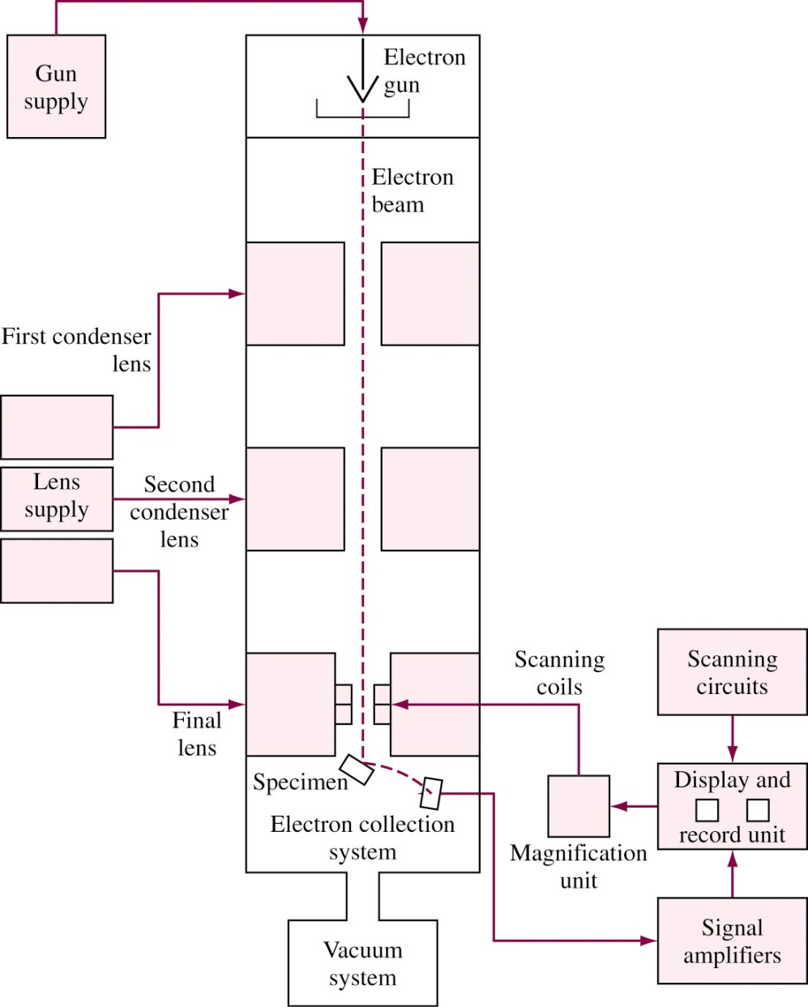
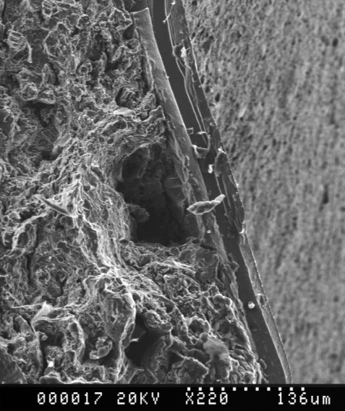
Scanning Electron Microscope
Electron source generates electrons. W, LaB₆, FE
Electrons hit the surface and secondary electrons are produced.
The secondary electrons are collected to produce the signal.
The signal
is used to
produce
the image.
場發射
SEM of fractured metal end
掃描式電子顯微鏡(SEM)

Slide 48
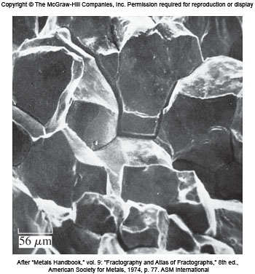
Scanning Electron Microscope (Cont…)
Depth of field 景深: 300 times that of OM. 10 μm at 10,000×
Magnification: 15× -500,000×
The samples are often coated with Au or C especially for nonconducting materials.
Chemical analysis: SEM is always equipped with an X-ray spectrometer.
Fig. SEM fractograph of intergranular corrosion fracture near a circumferential weld in a thick-wall tube made of type 304 stainless steel.

Slide 49
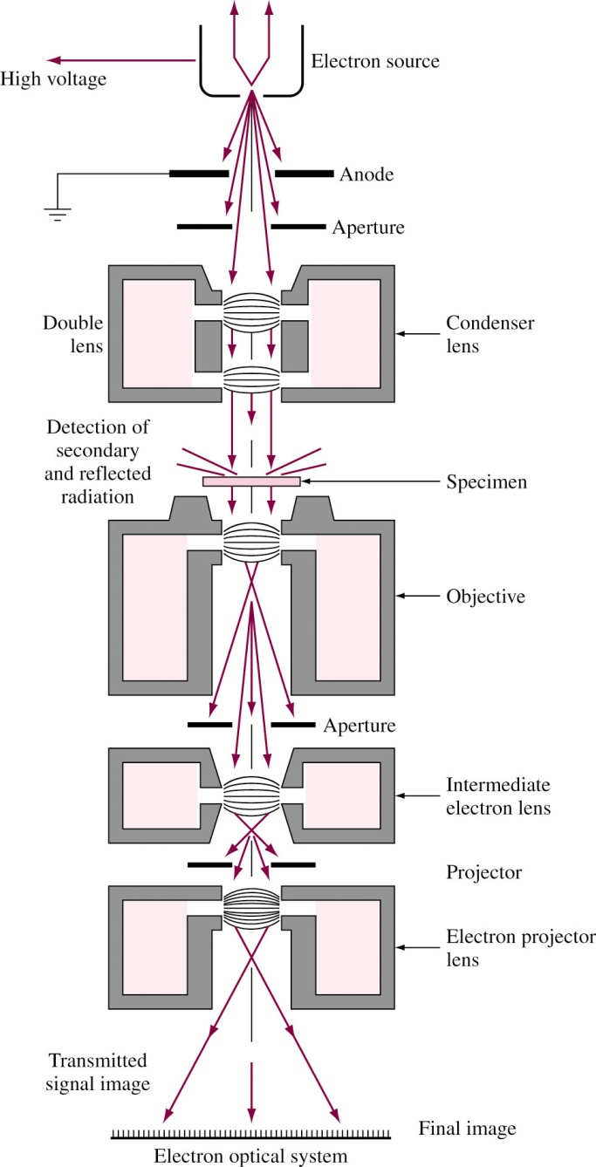
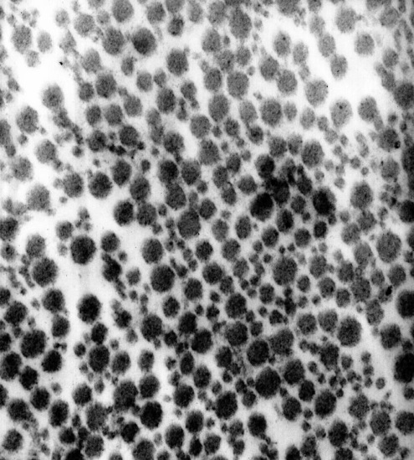
Transmission Electron Microscope
Electron produced by heated tungsten filament.
Accelerated by high voltage (75-300 kV)
Electron beam passes through very thin specimen.
Difference in atomic arrangement change directions of electrons.
Beam is enlarged and focused on fluorescent screen.
Bright field vs. Dark field images.
聚焦鏡
Collagen Fibrils
膠原纖維 of ligament 韌帶 as seen in TEM
試樣
物鏡
中間鏡
投射鏡
穿透式電子顯微鏡(TEM)

Slide 50
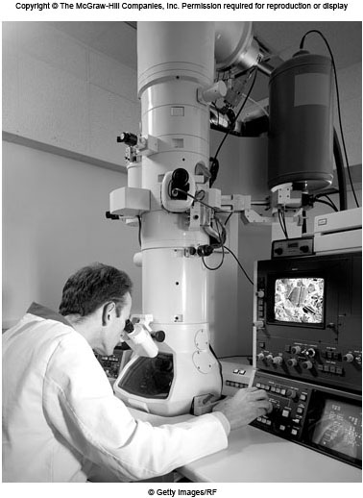
TEM (Cont…)
TEM needs complex sample preparation.
Electropolishing, ion-beam thinning, and focus ion beam (FIB).
Very thin specimen needed ( several hundred nanometers)
Magnification: 50× -1,500,000×
Diffraction and chemical analysis.
聚焦離子束

Slide 51
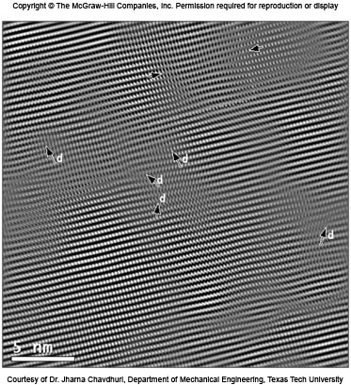
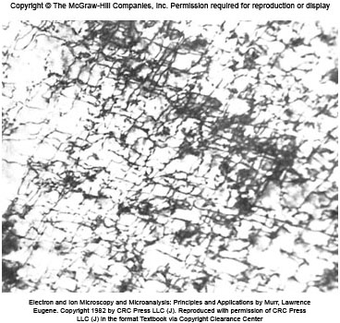
TEM and HRTEM Images
Fig. 4.33 TEM bright field image shows dislocation structure in iron deformed 14% at 78 K.
Fig. 4.34 HRTEM image of AlN atomic structure. Dislocation: d Stacking fault: two opposing arrows.
高解析穿透式電子顯微鏡(HRTEM)

Slide 52
High-Resolution TEM
High resolution TEM (HRTEM) allows resolution of 0.1 nm, atomic level.
The sample must be significantly thinner—on the order of 10-15 nm.
2-D projections of a crystal with accompanying defects can be observed.
The thin sample is tilted so that a low-index direction in the plane is perpendicular to the direction of electron beam.
Dislocations create a wavy pattern in atomic structure.

Slide 53

Scanning Probe Microscopy (SPM)
掃描探針顯微鏡
SPM: Scanning Tunneling Microscope (STM) and Atomic Force Microscope (AFM).
Sub-nanometer magnification.
Atomic scale topographic map of surface.
STM uses extremely sharp tip (W, Ni, Pt-Ir or carbon nanotubes).
掃描穿隧顯微鏡
原子力顯微鏡
Fig. 4.35 STM tip made of Pt-Ir alloy. The tip is sharpened using chemical etching techniques.

Slide 54

Scanning Tunneling Microscope
Tip placed one atom diameter from surface.
Voltage applied across tip and surface.
Electrons tunnel the gap and produce current.
Current produced is proportional to change in gap.
Can be used only for conductive materials.
Constant current mode Constant height mode

Slide 55



STM Images
Fig. 4.37 STM image of the surface of platinum showing outstanding atomic resolution.
Surface of platinum with defects

Slide 56

Atomic Force Microscope
Similar to STM but tip attached to cantilever beam.
When tip interacts with surface, van der Waals forces deflect the beam.
Deflection detected by laser and photodetector.
Short-range repulsive force (contact mode) vs. Long-range attractive force (non-contact mode)
Non-conductive materials can be scanned.
Used in DNA research and polymer coating technique.
懸臂樑

Slide 57
Summary
Metals: Melted and cast into ingots or parts.
Solidification → Polycrystalline grain → Grain size.
ASTM grain size number n or average grain diameter.
Large Si single crystals are used in IC industries and this Si must be of very high purity.
Crystal Imperfections: Point defects: vacancies, solutes. Line defects: edge and screw dislocations. Two-dimensional defects: surfaces, internal boundary. Three-dimensional defects: pores, inclusions, cracks.
Microstructure Analysis: OM, SEM, TEM, HRTEM, STM, AFM.

